Slide 1
CSS
MCNDHS
Ms. Eng

Slide 2
AIM: CSS-BOXES-OPACITY AND BORDER RADIUS
Do now:
Daily Grade:
On-time/attendance/not leaving the classroom: 25%
Cellphones: 25%
Notes:25%
Classwork/Homework: 25%

Slide 3

WHERE YOU SEE IT:

Slide 4
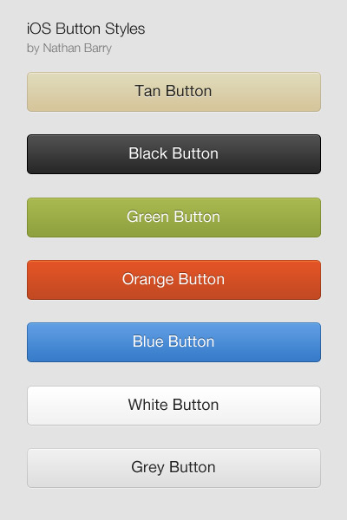
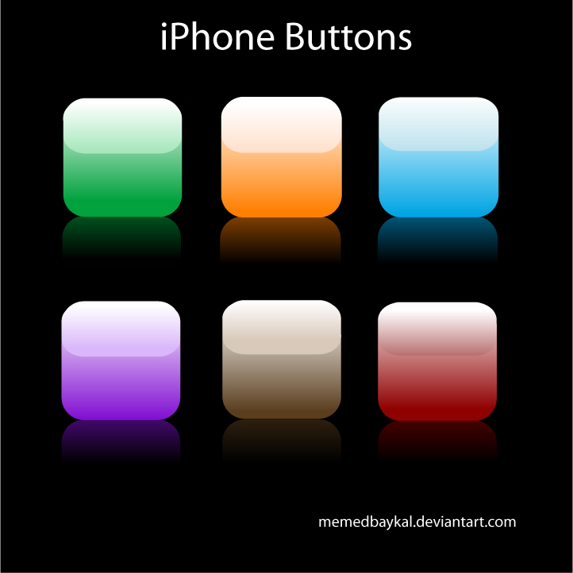
WHERE YOU ALSO SEE IT

Slide 5
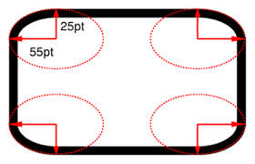
DESCRIPTION

Slide 6

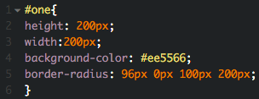

EXAMPLE CODE:

Slide 7

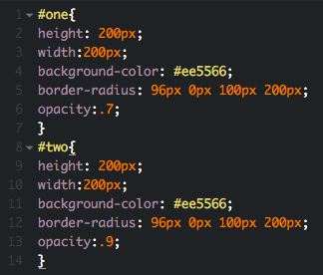
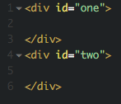
OPACITY:
0.0 - .5 Light
.5 - 1.0 Dark

Slide 8


ACTIVITY

